Slide 1

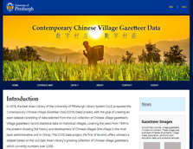

Improving Accessibility and Understandability of Open Research Data
-- Metadata and Data Guide to the CCVG Data Project at the University of Pittsburgh Library System
Fanghui Xiao, School of Computing and Information
Haihui Zhang, University of Pittsburgh Library System
University of Pittsburgh

Slide 2

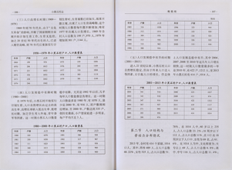
Project Overview
Contemporary Chinese Village Gazetteer Data Project (CCVG Data)
Led by East Asian Library (EAL), University Library System (ULS)
  Supported by the Provost in 2018
  Collaborate with School of Computing and Information
Aim to extract data from ULS’s Chinese village gazetteer collection
  12 Topics include Natural Information, Population, Politics and Management, Economics, Education, etc.

Slide 3


Project Overview
Focus on administrative villages in China
  Present: 1,800 villages
    Cover 31 provinces (including municipalities), 212 cities, 510 counties
  Goal: reach 2,500-3,000
Extracted Data in 18 categories and 147 subcategories
  E.g., Number of Civil Mediations
  E.g., Agricultural / Industrial / Household / Commercial Electricity Price

Slide 4
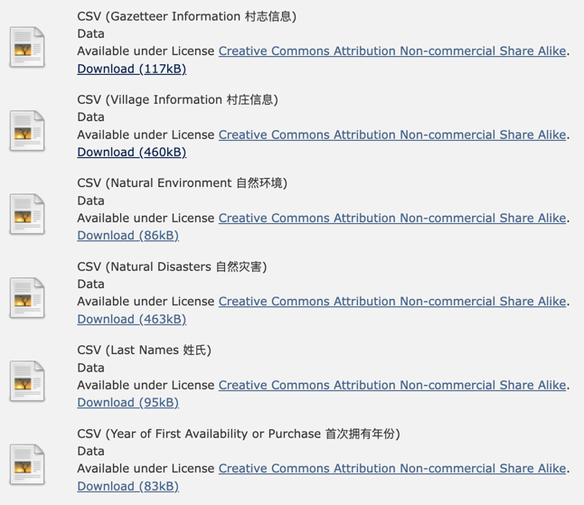
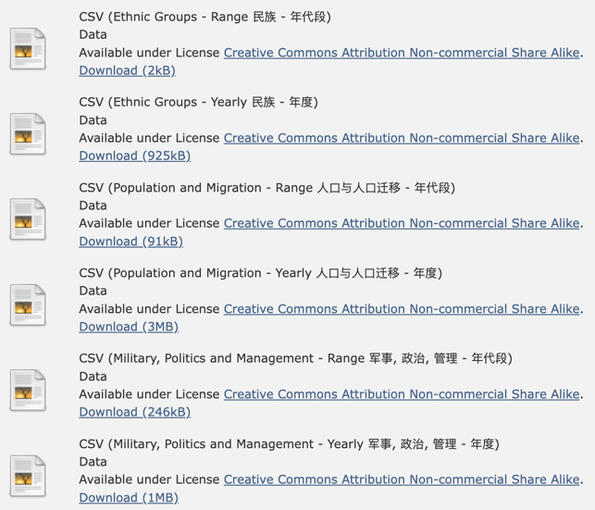
Project Overview —Datasets
18 datasets in total

Slide 5
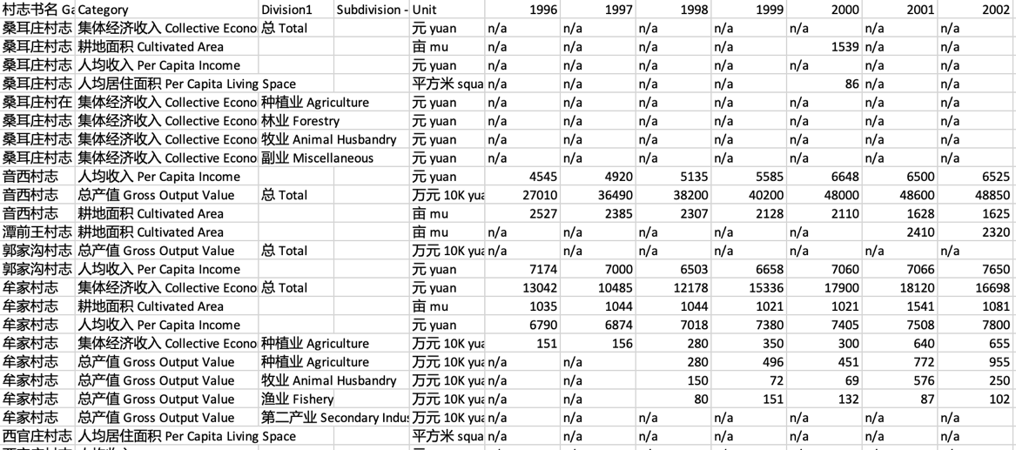
Project Overview—Data
Example: CSV (Economy - Yearly 经济 - 年度)

Slide 6
Metadata Design
Data
Dictionary
Database
Metadata
Data Guide
Finished
In the progress
Future plan

Slide 7
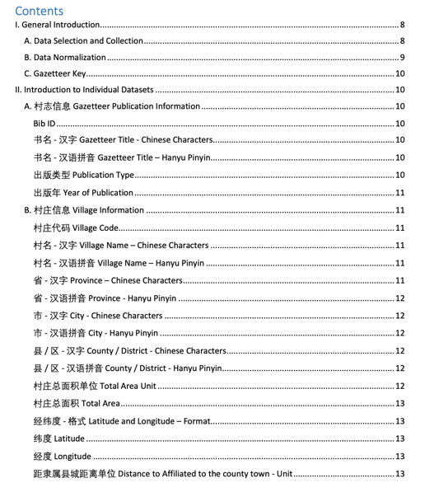


Data Dictionary
Bilingual: Chinese and English
General Introduction
General Introduction
Introduction to Individual Dataset
Introduction to Individual Dataset
Data
Dictionary
Link: http://d-scholarship.pitt.edu/37663/160/CCVG%20Data%20Dictionary.pdf

Slide 8
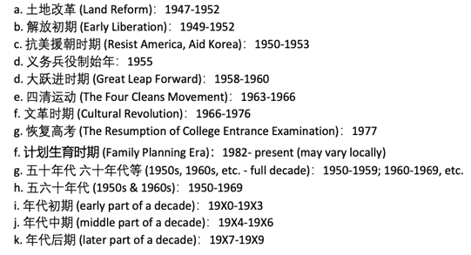
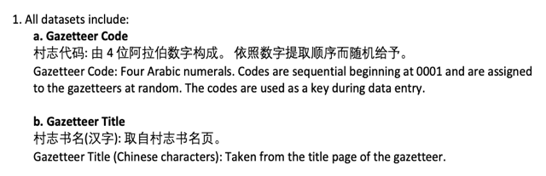
Data Dictionary— General Introduction
  Data Selection and Collection
  E.g., All data are taken from the village gazetteers, except administrative levels and village code, which from related government website.
  E.g., Data are recorded using the original measurement units provided in the gazetteer.
Data Normalization
Gazetteer Key

Slide 9
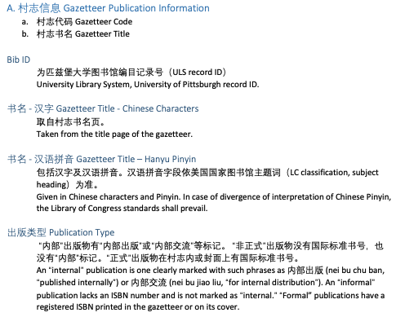
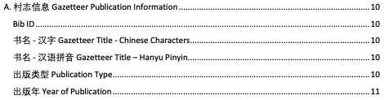
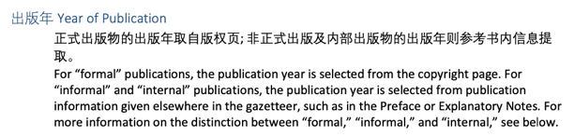
Data Dictionary— Introduction to Individual Datasets
Example: 村志信息 Gazetteer Publication Information

Slide 10
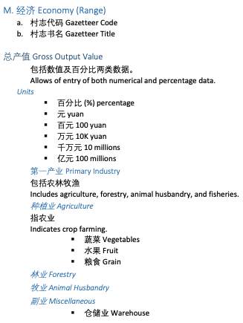
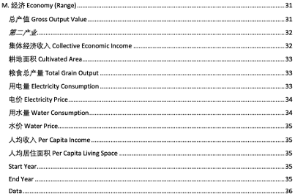
Data Dictionary—Introduction to Individual Datasets
Example: 经济 Economy

Slide 11
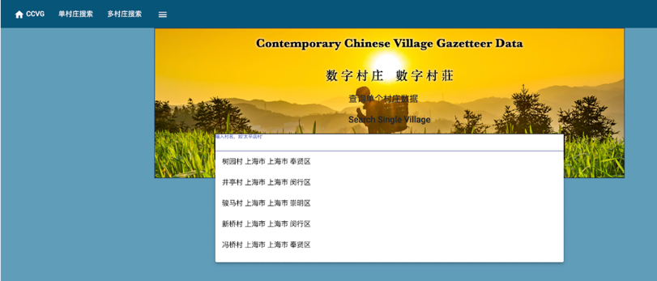
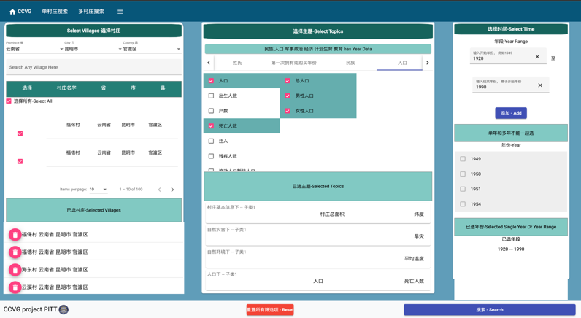
Database Metadata

Slide 12
Database Metadata
Description
Contributor
Publication date
Creation date
Last updated date
Data format
Identifier
Language
File type
Copyright status
License terms
Rights holder
Descriptive Metadata
Technical Metadata
Preservation Metadata
Rights Metadata
Metadata Attributes

Slide 13
Data Guide
Survey sample: 33 participants
How important is the following contextual information in the current CCVGD data dictionary in helping you reducing confusion, uncertainty, and ambiguity when working with datasets?
Data collection and creation process
Information about publisher
Citation information

Slide 14
Data Guide
How important is the following information that might help you gain insights when working with datasets?
Publisher's purposes for collecting and publishing the datasets
Potential uses of a dataset
Examples of how the data has been used

Slide 15
Data Guide
How important is the following information that might help you find connections between datasets?
The relationships (scenario-based connections) with other datasets within the same data repository
Cross-linking to other sites' data that related to the data that you are looking at

Slide 16
Data Guide
How important is the following information that might help you structure the datasets? (knowing how data inside the current database is organized?)
Database schema
History of data formats

Slide 17
Data Guide
Overall, to what extent do you think a Data Guide can help with using the datasets?
Data collection and creation process
Information about publisher
Citation information
Publisher's purposes for collecting and publishing the datasets
Potential uses of a dataset
Examples of how the data has been used
The relationships (scenario-based connections) with other datasets within the same data portal
Cross-linking to other sites' data that related to the data that you are looking at
Database schema
History of data format
Data Guide

Slide 18
Thank you & Questions?
Notes:
That’s our presentation for today. Thank you for your attention and please feel free to ask if you have any questions or suggestion.

